Slide 1
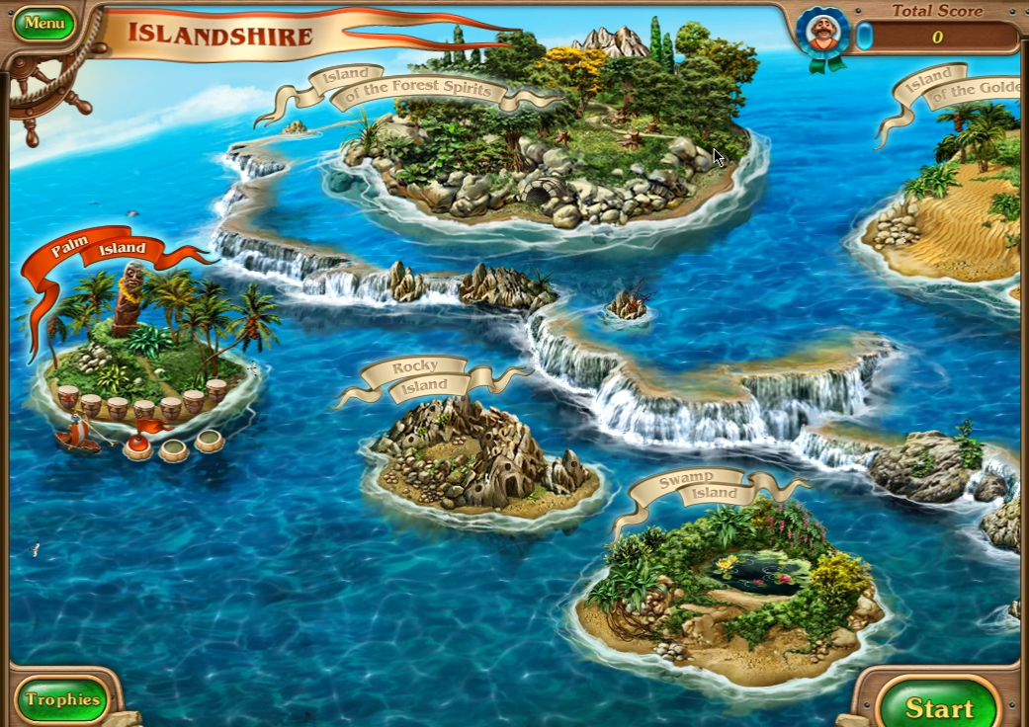

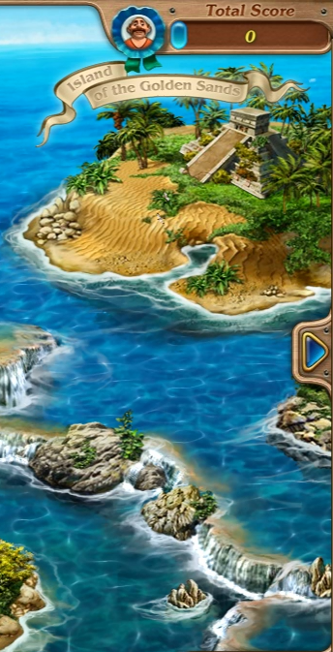
BACK
Coming
Mystery
Cave
Soon
Tropical
Cave
Horror
Cave
Swamp
Cave

